Slide 1


Slide 2
Web scraping project

Slide 3

Content
Motivation
Data
Interesting Findings
Challenges
Next steps

Slide 4
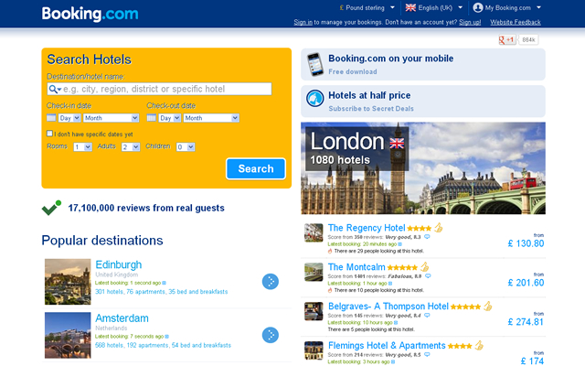
Motivation
Booking.com is a Dutch online travel agency
for lodging reservations & other travel products
#1 most visited travel site by traffic
100+ million visits a month
Over 950,000 hotels in 187 countries.
41,000 destinations worldwide.
Available in 43 languages.
Simple steps to a quick and secure Booking.
- No booking fees. You just pay the hotel, not us.
- Over 95 million guest reviews from real guests.
- Hotel photos and maps to help you find the best fit for you.

Slide 5
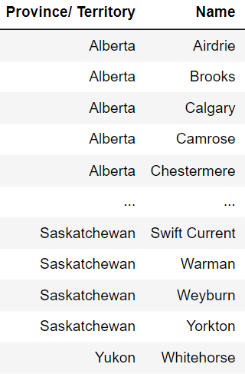
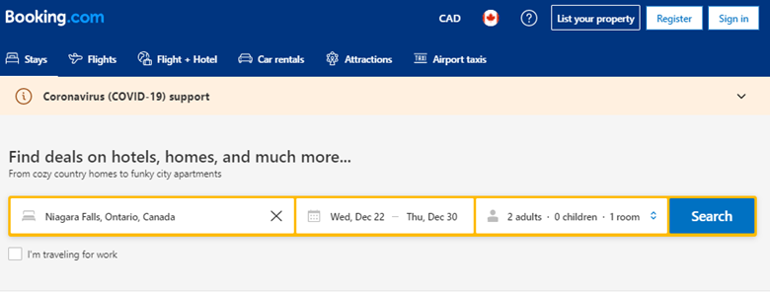
.
Website Scrapping Journey main page

Slide 6
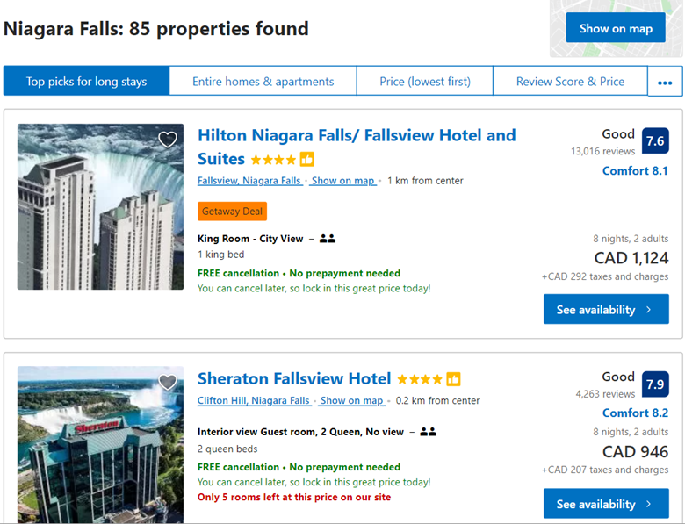
Website Scrapping Journey city page

Slide 7
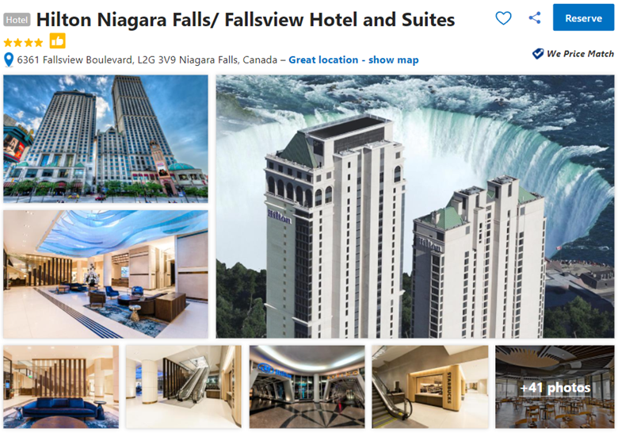
Website Scrapping Journey hotel page

Slide 8
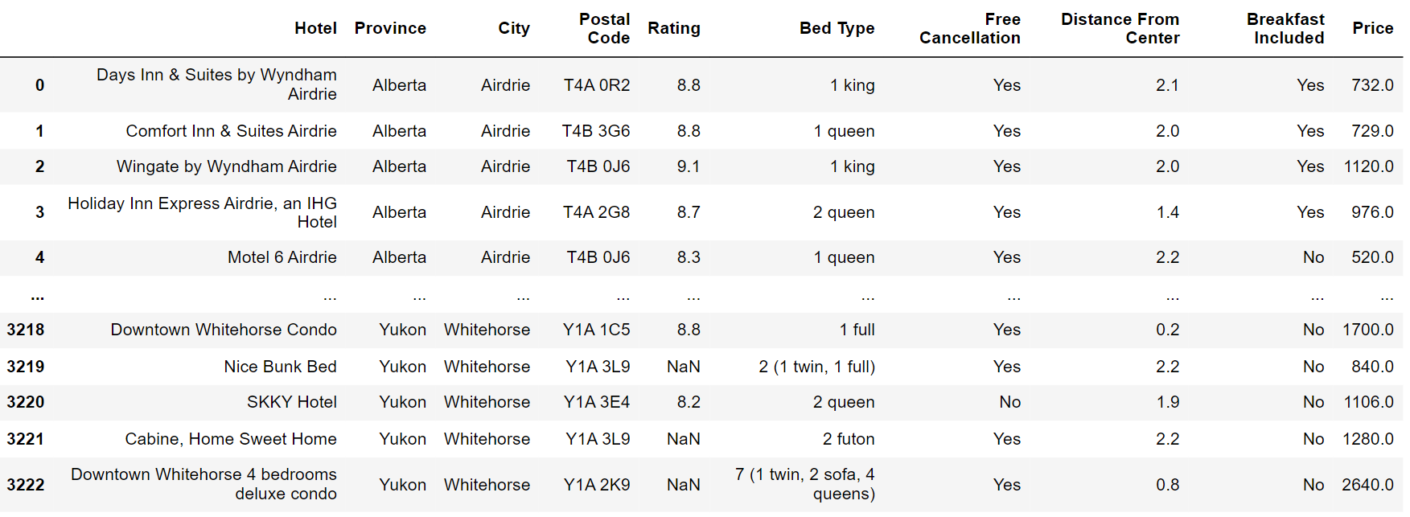
.
Data frame
Total data recorded:
3,223 ⨯ 10
Time Range:
Dec 22, 2021 – Dec 30, 2021

Slide 9

.
Interesting findings
Average Price per Province
Is breakfast included ?
Scenario based analyze
Mapped hotels based on the price
Quantity of the hotels by the distance from the center
Min , Max & Mean of Rating per Province

Slide 10
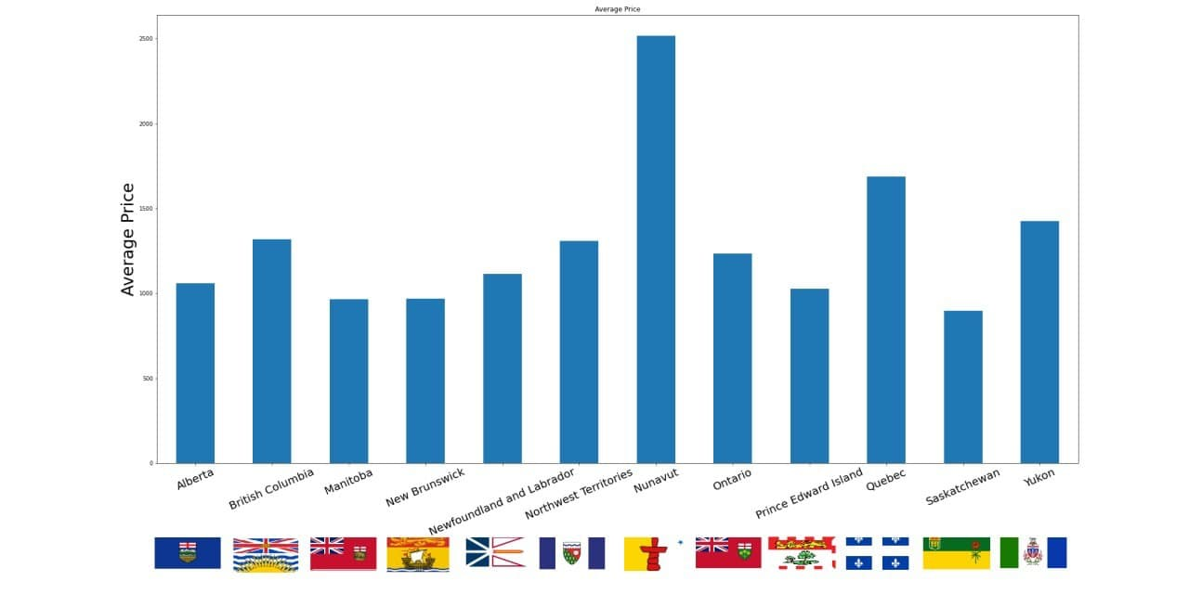
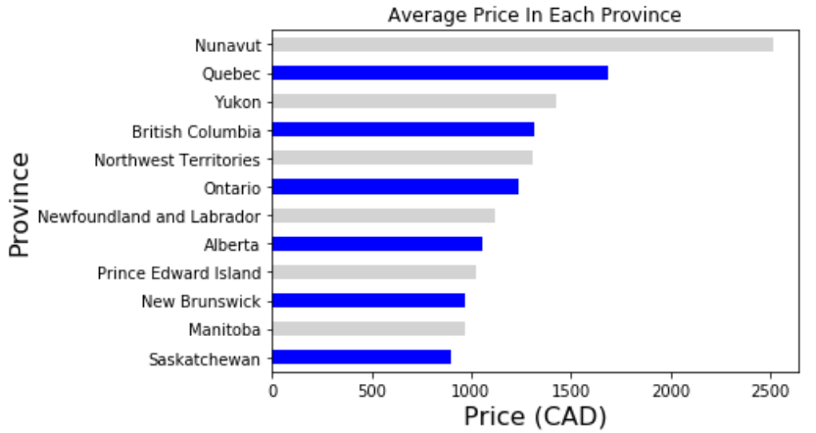
Average price per province

Slide 11
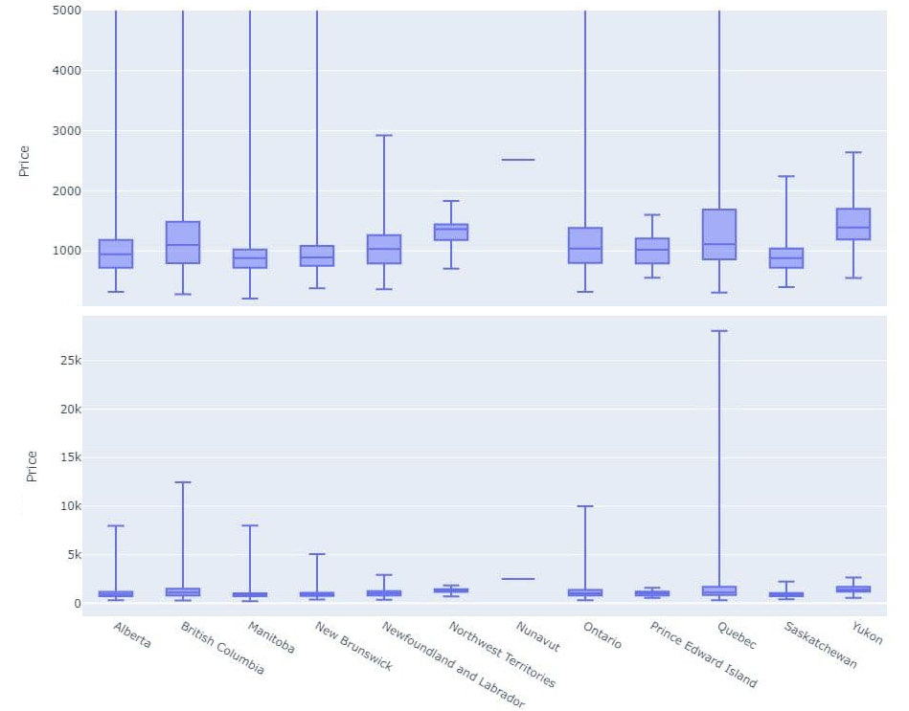

Slide 12
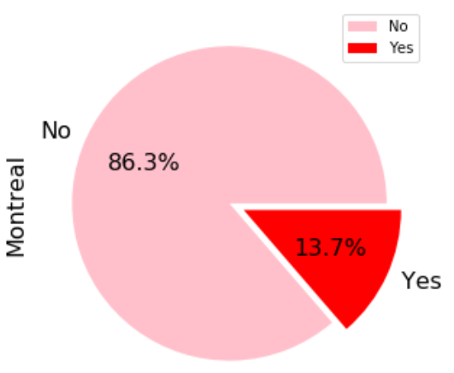
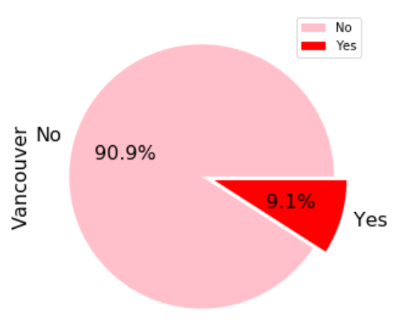
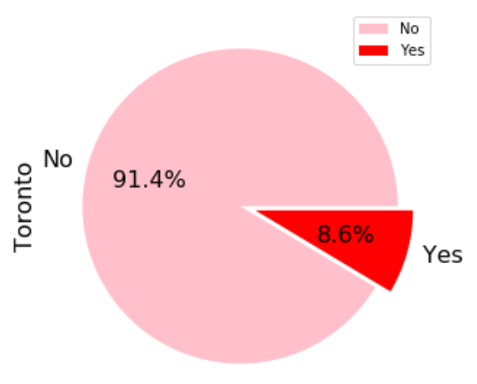
Breakfast included? Canada Metropolitan Areas

Slide 13
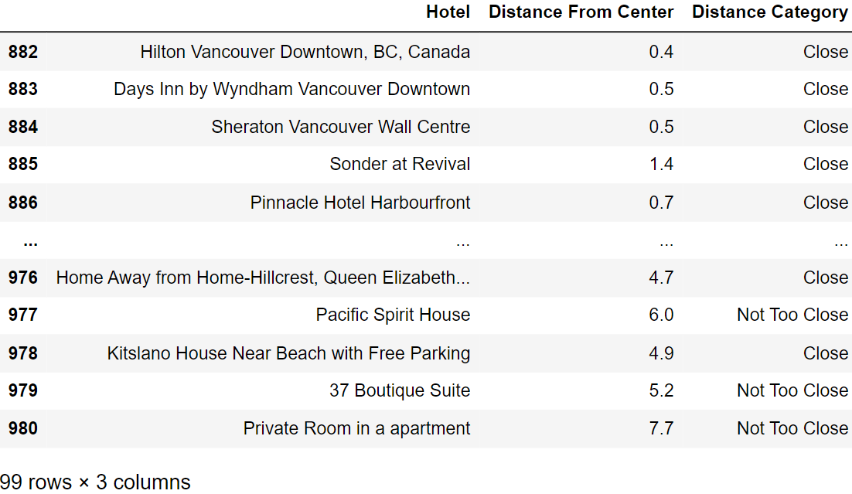
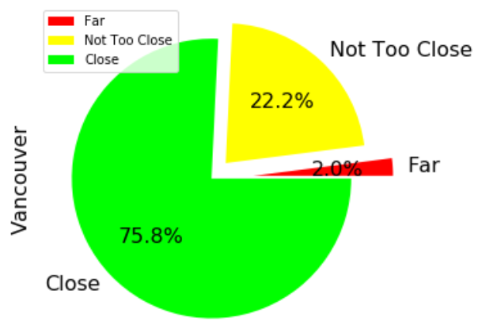
Distance From Center Matters? –Vancouver
Close:
Distance from center less than 5 KM
Not Too Close:
Distance from center between 5 KM and 15 KM
Far:
Distance from center over 15 KM

Slide 14
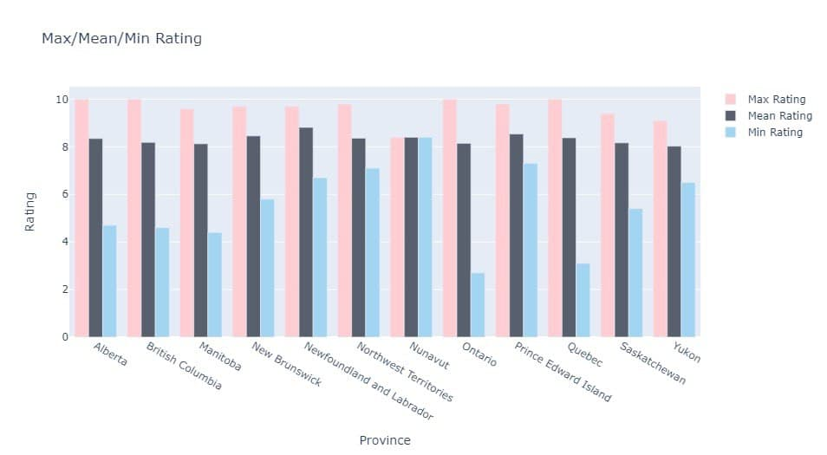

Hotel Rating Data in Provincial Areas

Slide 15
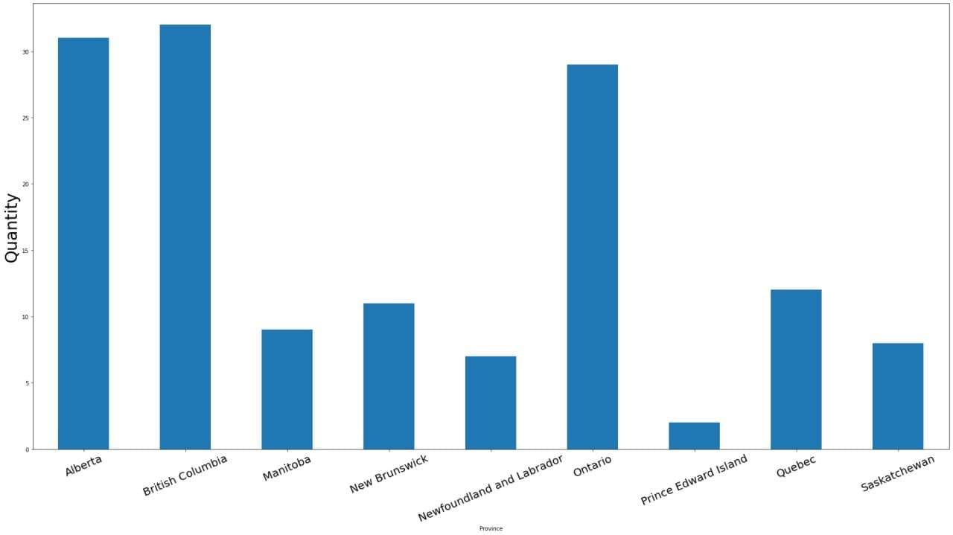
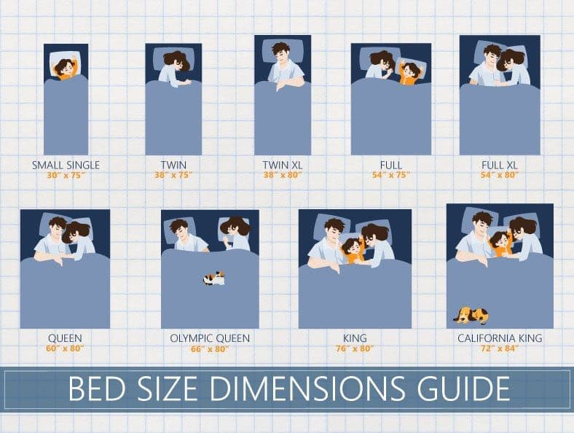
Scenario based analyze
Rating > 8
Price < 800 CAD
Distance from the centre < 5 km
3 < Bed Type Score <= 5

Slide 16
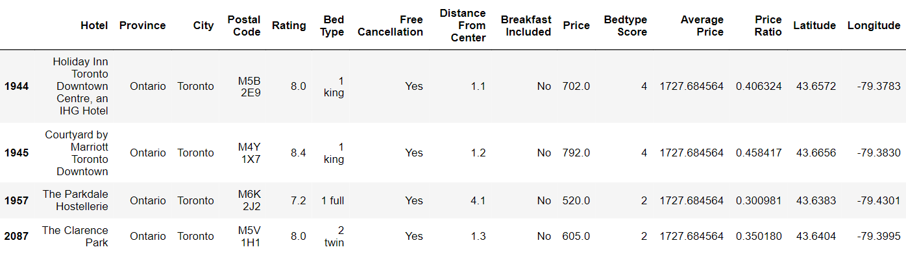
Traveler 1 :
Destination:
Toronto
Budget Limit:
$800
Free Cancellation:
YES
Maximum Distance From City Center:
Max. 5 KM

Slide 17
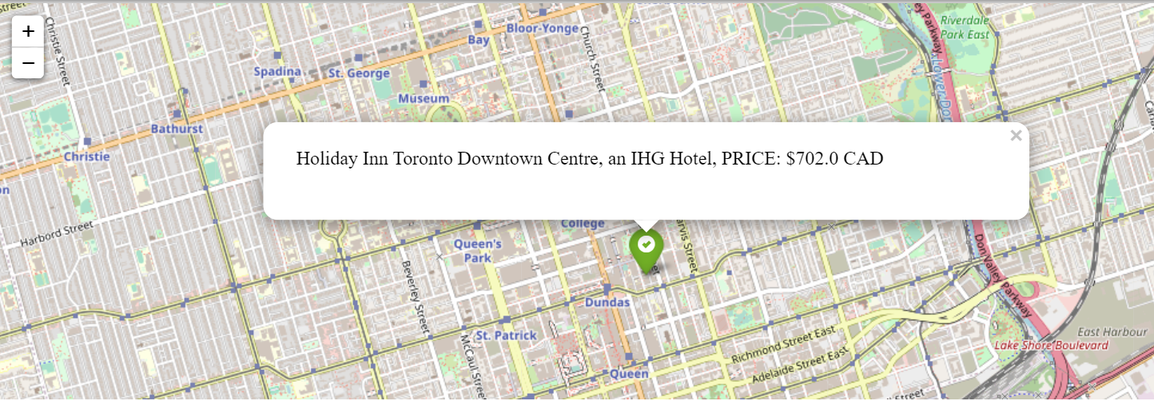
Traveler 1 :

Slide 18
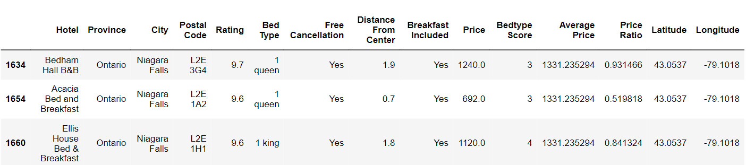
Traveler 2 :
Destination:
Niagara Falls
Budget Limit:
$1500 CAD
Breakfast Included:
YES
Minimum Rating:
Max. 5 KM
Free Cancellation:
YES
Least Distance From City Center:
Max. 5 KM

Slide 19
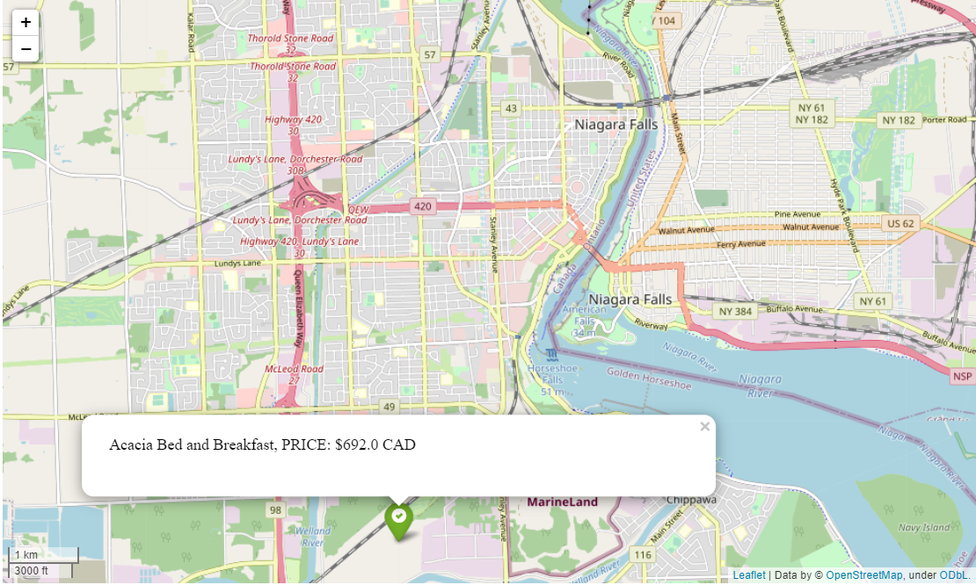
Traveler 2 :

Slide 20
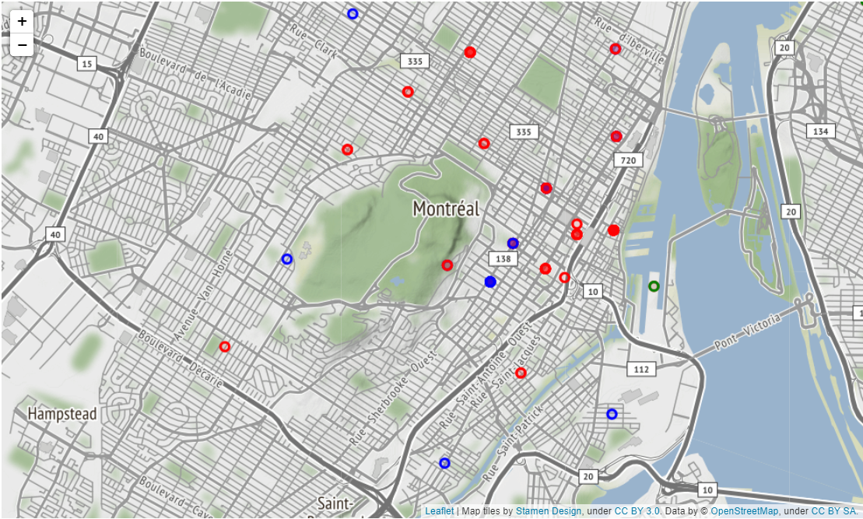
Hotel clustering Based on price: Montreal
Green:
Hotels with a price less than
$500 CAD
Blue:
Hotels with a price between $500
and $1500 CAD
Red:
Hotels with a price over
$1500 CAD

Slide 21
Challenges

Slide 22
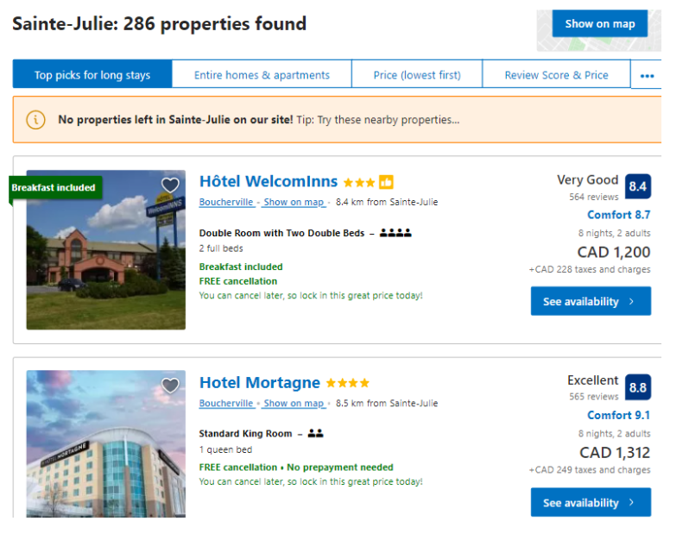
1. Booking.com displays listings for cities
Even if they don’t have any hotels available.
This makes duplicate record in our data.
2. The yellow box is not at the same place
Always. That’s why we should use XPATH.
3. Some cities with no hotels are redirected to
Cities with similar names. Sometimes the city
Is not even in Canada.

Slide 23

Next steps ? Web/Desktop App …

Slide 24

Happy Vacations !

Slide 25
Thank you

